Slide 1

Documentation: URL Scraping from thinkhazard

Slide 2
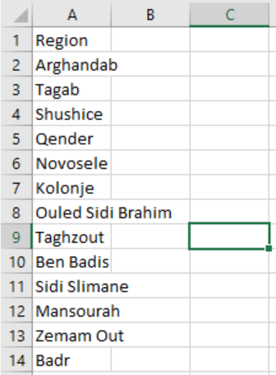
File 1: get_url.py
Purpose: Get URLs from region name
This script extracts URLs specific to given regions from the https://thinkhazard.org/en/ website. The script utilizes the Selenium library to automate browser interactions, simulating the search process for a region and capturing the resulting URL.
Required Libraries:
selenium: For web scraping and automating browser interactions.
pandas: For data processing and handling.
multiprocessing: For parallel processing to speed up the scraping process.
Input and Output:
Input: An Excel file get_url.xlsx with a 'Region' column containing the names of the regions to scrape.
Output: Two CSV files:
scraped_urls.csv: Contains the regions and their corresponding scraped URLs.
blocked_regions.csv: Contains regions where scraping failed (potentially blocked or an error occurred).
Figure 1: Input demonstration

Slide 3
Workflow:
1. Setup WebDriver: Set up a Chrome WebDriver with specific options for headless browsing (i.e., without opening a UI browser window).
2. Web Interaction:
Navigate to https://thinkhazard.org/en/.
Handle modals/pop-ups (if any).
Use the search bar to enter the region name.
Navigate to the page of the entered region.
3. Data Extraction:
Extract the current URL (which is specific to the region).
4. Error Handling:
If an error occurs (like being blocked or not finding an element), capture the region name and log it.
5. Parallel Execution:
The script processes multiple regions concurrently using multiprocessing to speed up the scraping process.
6. Output Saving:
Save the extracted URLs and blocked regions to separate CSV files.
Functions:
scrape_region(region): This function takes a region name as an argument. It automates the browser to search for the region on https://thinkhazard.org/en/ and extracts the resulting URL. If the extraction fails, it captures the region name as blocked.
Main Execution:
Read the input Excel file and retrieve the list of regions.
Use multiprocessing to concurrently scrape URLs for different regions.
Process the results to separate successful URL extractions and blocked regions.
Save the results to corresponding CSV files

Slide 4
File 2: region_get.py
Purpose: Get region names from URLs
This script scrapes region names given the specific URLs from the https://thinkhazard.org/en/ website. The data includes country, region highlevel (HL), region granularity (gran), and the region's URL. This is to make sure that the country, region granular and region high level matches with the URLs.
Required Libraries:
scrapy: For web scraping.
pandas: For data processing and handling.
Input and Output:
Input: An Excel file named get_regions.xlsx which should contain a column named url with URLs of regions to be scraped. (screenshot attached below)
Output: A CSV file named scraped_regions.csv that contains scraped data (country, region hazard level, region granularity, and the region's URL).
Workflow:
The spider reads the input Excel file to get the list of URLs.
For each URL, the spider sends a request to the website.
Upon receiving the response, the spider extracts data using specified XPaths.
Extracted data is stored in a Pandas DataFrame.
Once all the URLs are processed, the spider exports the DataFrame to a CSV file.

Slide 5
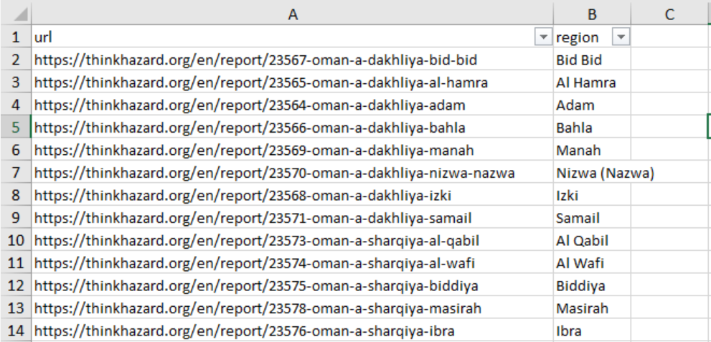
File 3: sprider.py
Purpose: Scrape Disaster Data
This script scrapes disaster risk-related data for specific regions from the https://thinkhazard.org/en/ website. The data includes disaster types and their corresponding risk levels for each region.
Required Libraries:
scrapy: For web scraping.
pandas: For data processing and handling.
Input and Output:
Input: An Excel file named get_disasters.xlsx which should contain columns named url and region with URLs of regions and their corresponding names to be scraped.
Output: A CSV file named scraped_disasters.csv that contains the disaster type and its risk level for each region.
Workflow:
The spider reads the input Excel file to get the list of URLs.
For each URL, the spider sends a request to the website.
Upon receiving the response, the spider extracts data using specified XPaths.
Extracted data is processed, converted to a structured format, and stored in a Pandas DataFrame.
Once all the URLs are processed, the spider merges the scraped data with the input data on the region column and exports the result to a CSV file.
Figure 2: Input demonstration

